Slide 1
Module 1: Securing Networks
Networking Security v1.0
(NETSEC)
Notes:
Networking Security (NETSEC) Module 1: Securing Networks

Slide 2
1.1 Current State of Affairs
Notes:
1: Securing Networks 1.1: Current State of Affairs

Slide 3
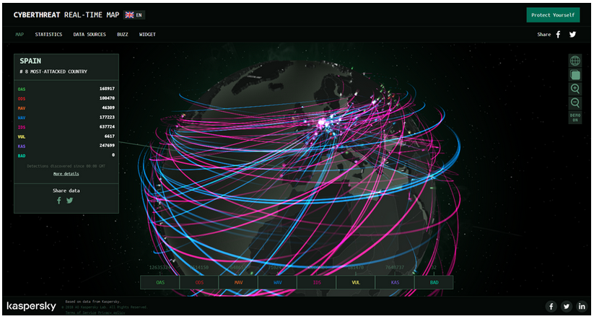
Current State of Affairs
Networks Are Targets
Networks are routinely under attack. A quick internet search for network attacks will return many articles about them. Kapersky maintains the interactive Cyberthreat Real-Time Map display of current network attacks. The attack data is submitted from Kapersky network security products that are deployed worldwide.
Notes:
1: Securing Networks 1.1: Current State of Affairs 1.1.1: Networks Are Targets

Slide 4
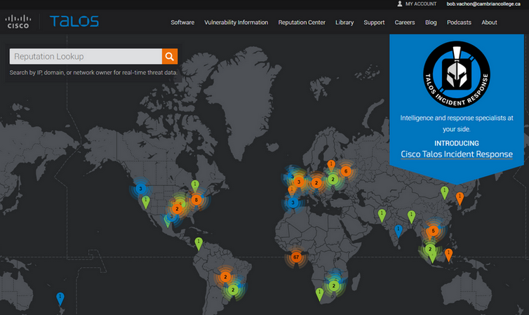
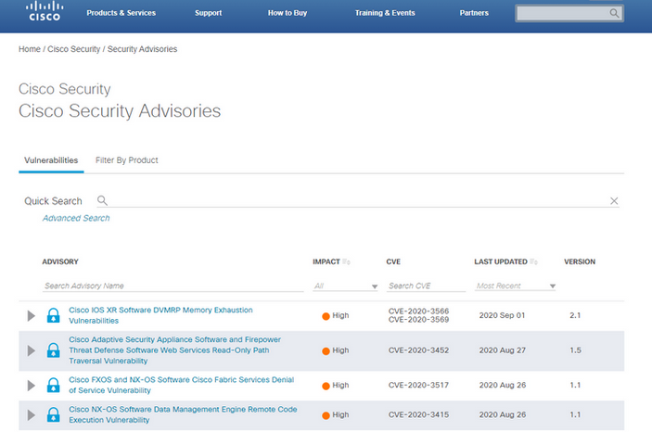
Current State of Affairs
Reasons for Network Security
Network security breaches can disrupt e-commerce, cause the loss of business data, threaten people’s privacy, and compromise the integrity of information. The Cisco Talos Intelligence Group website provides comprehensive security and threat intelligence. The Cisco Product Security Incident Response Team (PSIRT), is responsible for investigating and mitigating potential vulnerabilities in Cisco products.
Notes:
1: Securing Networks 1.1: Current State of Affairs 1.1.2: Reasons for Network Security

Slide 5
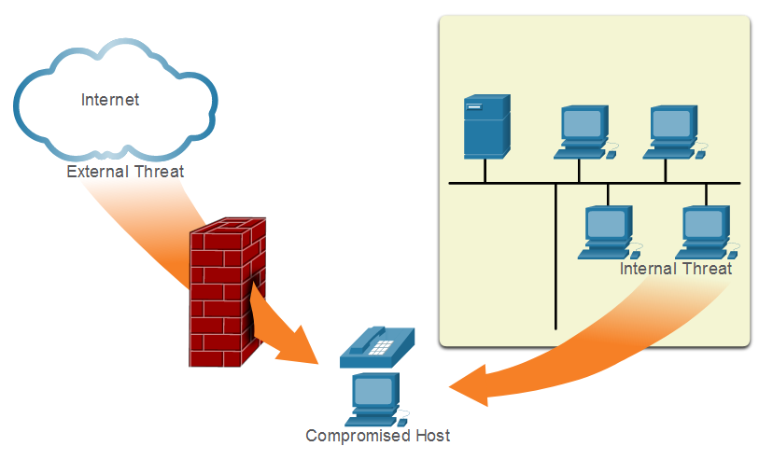
Current State of Affairs
Vectors of Network Attacks
An attack vector is a path by which a threat actor can gain access to a server, host, or network. Attack vectors originate from inside or outside the corporate network. Threat actors may target a network through the internet, to disrupt network operations and create a denial of service (DoS) attack.)
Notes:
1: Securing Networks 1.1: Current State of Affairs 1.1.3: Vectors of Network Attacks

Slide 6
Current State of Affairs
Data Loss
Term | Definition
Email/Social Networking | The most common vector for data loss includes instant messaging software and social media sites. For instance, intercepted email or IMs could be captured and confidential information revealed.
Unencrypted Devices | A stolen corporate laptop typically contains confidential organizational data. If the data is not stored using an encryption algorithm, the thief can retrieve valuable confidential data.
Cloud Storage Devices | Saving data to the cloud has many potential benefits. However, sensitive data can be lost if access to the cloud is compromised due to weak security settings.
Removable Media | One risk is that an employee could perform an unauthorized transfer of data to a USB drive. Another risk is that a USB drive containing valuable corporate data could be lost.
Hard Copy | Sensitive data should be disposed of thoroughly. For example, confidential data should be shredded when no longer required. Otherwise, a thief could retrieve discarded reports and gain valuable information.
Improper Access Control | Passwords are the first line of defense. Stolen passwords or weak passwords which have been compromised can provide an attacker easy access to data.
Notes:
1: Securing Networks 1.1: Current State of Affairs 1.1.4: Data Loss

Slide 7
1.2 Network Topology Overview
Notes:
1: Securing Networks 1.2: Network Topology Overview

Slide 8
Network Topology Overview
Campus Area Networks
Term | Definition
VPN | The Cisco ISR is secured. It protects data in motion that is flowing from the CAN to the outside world by establishing Virtual Private Networks (VPNs). VPNs ensure data confidentiality and integrity from authenticated sources.
ASA Firewall | A Cisco Adaptive Security Appliance (ASA) firewall performs stateful packet filtering to filter return traffic from the outside network into the campus network.
IPS | A Cisco Intrusion Prevention System (IPS) device continuously monitors incoming and outgoing network traffic for malicious activity. It logs information about the activity and attempts to block and report it.
Layer 3 Switches | These distribution layer switches are secured and provide secure redundant trunk connections to the Layer 2 switches. Several different security features can be implemented, such as ACLs, DHCP snooping, Dynamic ARP Inspection (DAI), and IP source guard.
Layer 2 Switches | These access layer switches are secured and connect user-facing ports to the network. Several different security features can be implemented, such as port security, DHCP snooping, and 802.1X user authentication.
ESA/WSA | A Cisco Email Security Appliance (ESA) and Web Security Appliance (WSA) provide advanced threat defense, application visibility and control, reporting, and secure mobility to secure and control email and web traffic.
AAA Server | An authentication, authorization, and accounting (AAA) server authenticates users, authorizes what they are allowed to do, and tracks what they are doing.
Hosts | End points are secured using various features including antivirus and antimalware software, Host Intrusion Protection System features, and 802.1X authentication features.
Notes:
1: Securing Networks 1.2: Network Topology Overview 1.2.1: Campus Area Networks

Slide 9
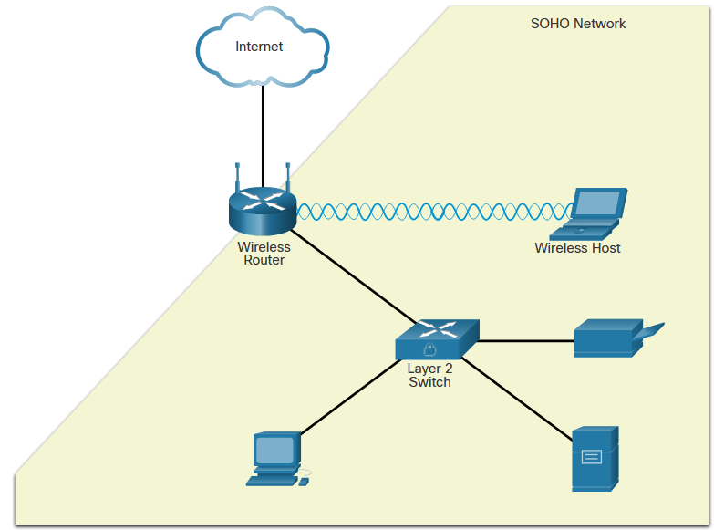
Network Topology Overview
Small Office and Home Office Networks
The figure displays a sample SOHO secured with a consumer-grade wireless router which provides integrated firewall features and secure wireless connections. The Layer 2 Switch is an access layer switch that is hardened with various security measures. It connects user-facing ports that use port security to the SOHO network. Wireless hosts connect to the wireless network using WPA2 data encryption technology. Hosts typically have antivirus and antimalware software installed. Combined, these security measures provide comprehensive defense at different layers of the network.
Notes:
1: Securing Networks 1.2: Network Topology Overview 1.2.2: Small Office and Home Office Networks

Slide 10
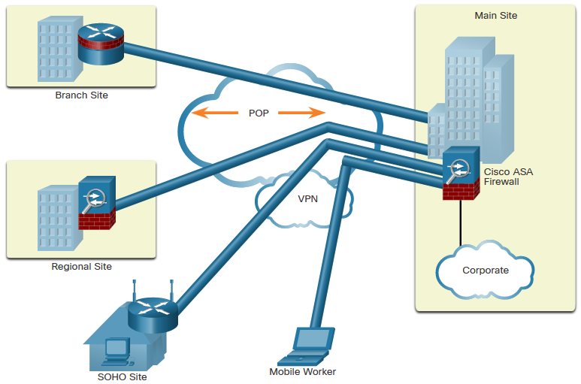
Network Topology Overview
Wide Area Networks
Wide Area Networks (WANs) span a wide geographical area, often over the public internet. Organizations must ensure secure transport for the data in motion as it travels between sites over the public network. Network security professionals must use secure devices on the edge of the network. In the figure, the main site is protected by an Adaptive Security Appliance (ASA), which provides stateful firewall features and establishes secure Virtual Private Network (VPN) tunnels to various destinations.
Notes:
1: Securing Networks 1.2: Network Topology Overview 1.2.3: Wide Area Networks

Slide 11
Network Topology Overview
Data Center Networks
Data center networks are typically housed in an off-site facility to store sensitive or proprietary data. These sites are connected to corporate sites using VPN technology with ASA devices and integrated data center switches. Because they store such vast quantities of sensitive, business-critical information, physical security is critical to their operation. Physical security not only protects access to the facility but also protects people and equipment. For example, fire alarms, sprinklers, seismically-braced server racks, redundant heating, ventilation, and air conditioning (HVAC), and UPS systems are in place to protect people, equipment, and data.
Data center physical security can be divided into two areas:
Outside perimeter security - This can include on-premise security officers, fences, gates, continuous video surveillance, and security breach alarms.
Inside perimeter security - This can include continuous video surveillance, electronic motion detectors, security traps, and biometric access and exit sensors.
Notes:
1: Securing Networks 1.2: Network Topology Overview 1.2.4: Data Center Networks

Slide 12
Network Topology Overview
Cloud Networks and Virtualization
The terms “cloud computing” and “virtualization” are often used interchangeably; however, they mean different things. Virtualization is the foundation of cloud computing. Without it, cloud computing, as it is most-widely implemented, would not be possible. Cloud computing separates the application from the hardware. Virtualization separates the operating system from the hardware. The cloud network consists of physical and virtual servers usually found in data centers. Data centers are increasingly using virtual machines (VM) to provide server services to their clients. This allows for multiple operating systems to exist on a single hardware platform. VMs are prone to specific targeted attacks:
Hyperjacking -An attacker could hijack a VM hypervisor (VM controlling software) and then use it as a launch point to attack other devices on the data center network.
Instant On Activation - When a VM that has not been used for a period of time is brought online, it may have outdated security policies that deviate from the baseline security and can introduce security vulnerabilities.
Antivirus Storms - This happens when all VMs attempt to download antivirus data files at the same time.
Notes:
1: Securing Networks 1.2: Network Topology Overview 1.2.5: Cloud Networks and Virtualization

Slide 13
Network Topology Overview
The Evolving Network Border
Smartphones, tablets, etc., are becoming substitutes for the office PC that is behind a firewall. This trend is known as Bring Your Own Device (BYOD). To accommodate this, Cisco developed the Borderless Network. In a Borderless Network, access to resources can be initiated by users from many locations, on many types of end devices, using various connectivity methods. Cisco devices support Mobile Device Management (MDM) features:
Data Encryption - MDM features can ensure that only devices that support data encryption and have it enabled can access the network and content.
PIN Enforcement - Enforcing a PIN lock is the first and most effective step in preventing unauthorized access to a device.
Data Wipe - Lost or stolen devices can be remotely fully- or partially-wiped, either by the user or by an administrator via the MDM.
Data Loss Prevention (DLP) - DLP prevents authorized users from doing careless or malicious things with critical data.
Jailbreak/Root Detection - Jailbreaking (on Apple iOS devices) and rooting (on Android devices) are a means to bypass the management of a device. MDM features can detect such bypasses and immediately restrict a device’s access to the network or assets.
Notes:
1: Securing Networks 1.2: Network Topology Overview 1.2.6: The Evolving Network Border
1.2.7: Check Your Understanding - Network Topology Protection Overview

Slide 14
Module 2: Network Threats
Networking Security v1.0
(NETSEC)
Notes:
Networking Security (NETSEC) Module 2: Network Threats

Slide 15
2.1 Who is Attacking Our Network?
Notes:
2: Network Threats 2.1: Who is Attacking Our Network?

Slide 16
Who is Attacking Our Network?
Threat, Vulnerability, and Risk
To understand network security, it is important to understand the terms threat, vulnerability, attack surface, exploit, and risk. Four common ways to manage risk are listed below.
Risk Management Strategy | Explanation
Risk acceptance | This is when the cost of risk management options outweighs the cost of the risk itself. The risk is accepted, and no action is taken.
Risk avoidance | This means avoiding any exposure to the risk by eliminating the activity or device that presents the risk. By eliminating an activity to avoid risk, any benefits that are possible from the activity are also lost.
Risk reduction | This reduces exposure to risk or reduces the impact of risk by taking action to decrease the risk. It is the most commonly used risk mitigation strategy. This strategy requires careful evaluation of the costs of loss, the mitigation strategy, and the benefits gained from the operation or activity that is at risk.
Risk transfer | Some (or all) of the risk is transferred to a willing third party such as an insurance company.
Notes:
2: Network Threats 2.1: Who is Attacking Our Network? 2.1.1: Threat, Vulnerability, and Risk

Slide 17
Who is Attacking Our Network?
Hacker vs. Threat Actor
As we know, “hacker” is a common term used to describe a threat actor. The term “hacker” has a variety of meanings, as follows:
A clever programmer capable of developing new programs and coding changes to existing programs to make them more efficient.
A network professional that uses sophisticated programming skills to ensure that networks are not vulnerable to attack.
A person who tries to gain unauthorized access to devices on the internet.
An individual who runs programs to prevent or slow network access to many users, or to corrupt or destroy data on servers.
You may see references to white hat, gray hat, and black hat hackers.
Notes:
2: Network Threats 2.1: Who is Attacking Our Network? 2.1.2: Hacker vs. Threat Actor

Slide 18
Who is Attacking Our Network?
Evolution of Threat Actors
Since hacking started in the 1960s with phone freaking, or phreaking, it has evolved to include many types of threat actors.
Threat Actor | Explanation
Script Kiddies | Script kiddies emerged in the 1990s. They are teenagers or inexperienced threat actors running existing scripts, tools, and exploits, to cause harm, but typically not for profit.
Vulnerability Brokers | Vulnerability brokers are grey hat hackers who attempt to discover exploits and report them to vendors, sometimes for prizes or rewards.
Hacktivists | Hacktivists are grey hat hackers who rally and protest against different political and social ideas.
Cybercriminals | Cybercriminal is a term for black hat hackers who are either self-employed or working for large cybercrime organizations.
State- Sponsored | State-Sponsored hackers are threat actors who steal government secrets, gather intelligence, and sabotage networks of foreign governments, terrorist groups, and corporations.
Notes:
2: Network Threats 2.1: Who is Attacking Our Network? 2.1.3: Evolution of Threat Actors

Slide 19

Who is Attacking Our Network?
Cybercriminals
Cybercriminals are threat actors who are motivated to make money using any means necessary.
While some cybercriminals work independently, they are more often financed and sponsored by criminal organizations.
It is estimated that globally, cybercriminals steal billions of dollars from consumers and businesses every year.
Notes:
2: Network Threats 2.1: Who is Attacking Our Network? 2.1.4: Cybercriminals

Slide 20
Who is Attacking Our Network?
Cybersecurity Tasks
Organizations must act to protect their assets, users, and customers. They must develop and practice cybersecurity tasks, including the following:
Use a trustworthy IT vendor
Keep security software up-to-date
Perform regular penetration tests
Back up to cloud and hard disk
Periodically change WIFI password
Keep security policy up-to-date
Enforce use of strong passwords
Use two factor authentication
Notes:
2: Network Threats 2.1: Who is Attacking Our Network? 2.1.5: Cybersecurity Tasks

Slide 21
Who is Attacking Our Network?
Cyber Threat Indicators
Many network attacks can be prevented by sharing information about indicators of compromise (IOC). Each attack has unique, identifiable attributes. Indicators of compromise are the evidence that an attack has occurred.
IOCs can be features that identify the following:
malware files
IP addresses of servers that are used in attacks
filenames
characteristic changes made to end system software
Indicators of attack (IOA) focus more on the motivation behind an attack and the potential means by which threat actors have, or will, compromise vulnerabilities to gain access to assets. IOAs are concerned with the strategies that are used by attackers.
Notes:
2: Network Threats 2.1: Who is Attacking Our Network? 2.1.6: Cyber Threat Indicators

Slide 22
Who is Attacking Our Network?
Threat Sharing and Building Cybersecurity Awareness
The US Cybersecurity Infrastructure and Security Agency (CISA) uses a system called Automated Indicator Sharing (AIS). AIS enables the sharing of attack indicators between the US government and the private sector as soon as threats are verified. CISA offers many resources that help to limit the size of the United States attack surface.
The CISA and the National Cyber Security Alliance (NCSA) promote cybersecurity to all users. For example, they have an annual campaign in every October called “National Cybersecurity Awareness Month” (NCSAM).
The European Union Agency for Cybersecurity (ENISA) delivers advice and solutions for the cybersecurity challenges of the EU member states.
Notes:
2: Network Threats 2.1: Who is Attacking Our Network? 2.1.7: Threat Sharing and Building Cybersecurity Awareness
2.1.8: Check Your Understanding - What Color is my Hat?

Slide 23
2.2 Threat Actor Tools
Notes:
2: Network Threats 2.2: Threat Actor Tools

Slide 24
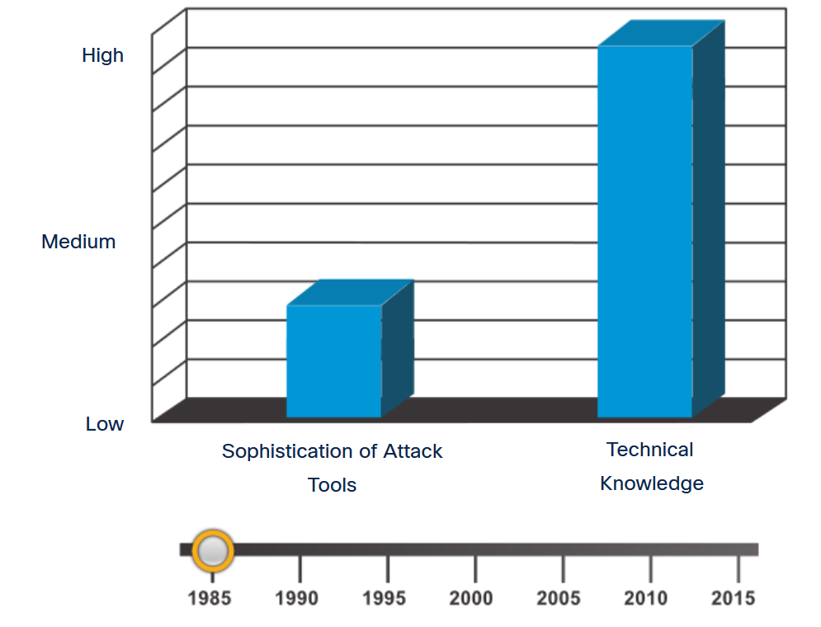
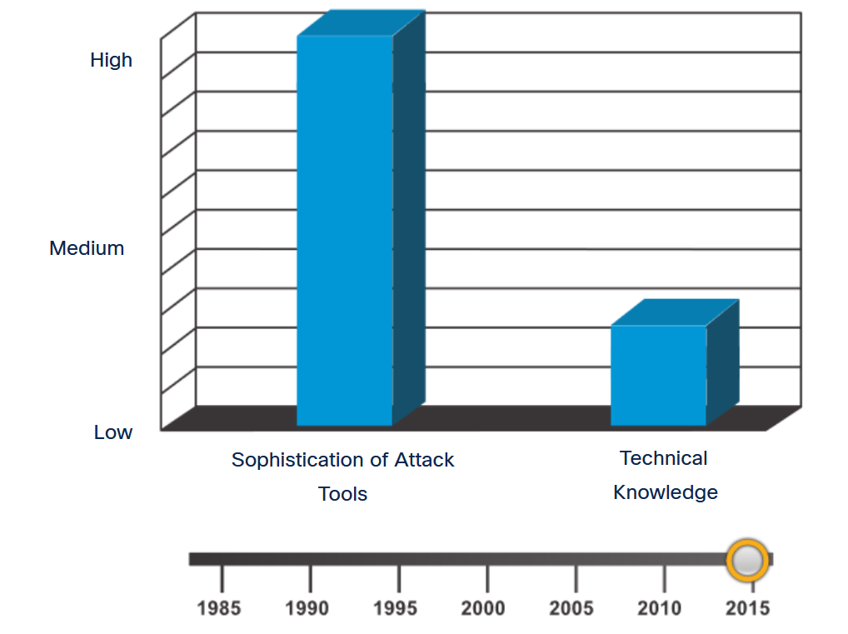
Threat Actor Tools
Introduction of Attack Tools
To exploit a vulnerability, a threat actor must have a technique or tool. Over the years, attack tools have become more sophisticated, and highly automated. These new tools require less technical knowledge to implement.
Notes:
2: Network Threats 2.2: Threat Actor Tools 2.2.1: Introduction of Attack Tools

Slide 25
Threat Actor Tools
Evolution of Security Tools
Ethical hacking uses many different types of tools to test the network and end devices. To validate the security of a network and its systems, many network penetration testing tools have been developed. However, many of these tools can also be used by threat actors for exploitation.
Categories of Tools | Description
password crackers | Passwords are the most vulnerable security threat. Password cracking tools are often referred to as password recovery tools and can be used to crack or recover the password. Password crackers repeatedly make guesses in order to crack the password and access the system. Examples of password cracking tools include John the Ripper, Ophcrack, L0phtCrack, THC Hydra, RainbowCrack, and Medusa.
wireless hacking tools | Wireless networks are more susceptible to network security threats. Wireless hacking tools are used to intentionally hack into a wireless network to detect security vulnerabilities. Examples of wireless hacking tools include Aircrack-ng, Kismet, InSSIDer, KisMAC, Firesheep, and NetStumbler.
network scanning and hacking tools | Network scanning tools are used to probe network devices, servers, and hosts for open TCP or UDP ports. Examples of scanning tools include Nmap, SuperScan, Angry IP Scanner, and NetScanTools.
packet crafting tools | Packet crafting tools are used to probe and test a firewall’s robustness using specially crafted forged packets. Examples of such tools include Hping, Scapy, Socat, Yersinia, Netcat, Nping, and Nemesis.
packet sniffers | Packet sniffer tools are used to capture and analyze packets within traditional Ethernet LANs or WLANs. Tools include Wireshark, Tcpdump, Ettercap, Dsniff, EtherApe, Paros, Fiddler, Ratproxy, and SSLstrip.
rootkit detectors | A rootkit detector is a directory and file integrity checker used by white hat hackers to detect installed root kits. Example tools include AIDE, Netfilter, and PF: OpenBSD Packet Filter.
Notes:
2: Network Threats 2.2: Threat Actor Tools 2.2.2: Evolution of Security Tools

Slide 26
Threat Actor Tools
Evolution of Security Tools (Cont.)
Categories of Tools | Description
fuzzers | Fuzzers are tools used by threat actors when attempting to discover a computer system’s security vulnerabilities. Examples of fuzzers include Skipfish, Wapiti, and W3af.
forensic tools | White hat hackers use forensic tools to sniff out any trace of evidence existing in a particular computer system. Example of tools include Sleuth Kit, Helix, Maltego, and Encase.
debuggers | Debugger tools are used by black hat hackers to reverse engineer binary files when writing exploits. They are also used by white hat hackers when analyzing malware. Debugging tools include GDB, WinDbg, IDA Pro, and Immunity Debugger.
hacking operating systems | Hacking operating systems are specially designed operating systems preloaded with tools and technologies optimized for hacking. Examples of specially designed hacking operating systems include Kali Linux, SELinux, Knoppix, Parrot OS, and BackBox Linux.
encryption tools | These tools safeguard the contents of an organization’s data when it is stored or transmitted. Encryption tools use algorithm schemes to encode the data to prevent unauthorized access to the data. Examples of these tools include VeraCrypt, CipherShed, Open SSH, OpenSSL, OpenVPN, and Stunnel.
vulnerability exploitation tools | These tools identify whether a remote host is vulnerable to a security attack. Examples of vulnerability exploitation tools include Metasploit, Core Impact, Sqlmap, Social Engineer Tool Kit, and Netsparker.
vulnerability scanners | These tools scan a network or system to identify open ports. They can also be used to scan for known vulnerabilities and scan VMs, BYOD devices, and client databases. Examples of these tools include Nipper, Securia PSI, Core Impact, Nessus, SAINT, and Open VAS.
Notes:
2: Network Threats 2.2: Threat Actor Tools 2.2.2: Evolution of Security Tools (Cont.)

Slide 27
Threat Actor Tools
Categories of Attacks
Category of Attack | Description
eavesdropping attack | An eavesdropping attack is when a threat actor captures and listens to network traffic. This attack is also referred to as sniffing or snooping.
data modification attack | Data modification attacks occur when a threat actor has captured enterprise traffic and has altered the data in the packets without the knowledge of the sender or receiver.
IP address spoofing attack | An IP address spoofing attack is when a threat actor constructs an IP packet that appears to originate from a valid address inside the corporate intranet.
password-based attacks | Password-based attacks occur when a threat actor obtains the credentials for a valid user account. Threat actors then use that account to obtain lists of other users and network information. They could also change server and network configurations, and modify, reroute, or delete data.
denial-of-service (DoS) attack | A DoS attack prevents normal use of a computer or network by valid users. After gaining access to a network, a DoS attack can crash applications or network services. A DoS attack can also flood a computer or the entire network with traffic until a shutdown occurs because of the overload. A DoS attack can also block traffic, which results in a loss of access to network resources by authorized users.
Notes:
2: Network Threats 2.2: Threat Actor Tools 2.2.3: Categories of Attacks
2.2.4: Check Your Understanding - Classify Cyber Attacks

Slide 28
Threat Actor Tools
Categories of Attacks (Cont.)
Category of Attack | Description
man-in-the-middle attack (MiTM) | A MiTM attack occurs when threat actors have positioned themselves between a source and destination. They can now actively monitor, capture, and control the communication transparently.
Compromised key attack | A compromised key attack occurs when a threat actor obtains a secret key. This is referred to as a compromised key. A compromised key can be used to gain access to a secured communication without the sender or receiver being aware of the attack.
sniffer attack | A sniffer is an application or device that can read, monitor, and capture network data exchanges and read network packets. If the packets are not encrypted, a sniffer provides a full view of the data inside the packet. Even encapsulated (tunneled) packets can be broken open and read unless they are encrypted, and the threat actor does not have access to the key.
Notes:
2: Network Threats 2.2: Threat Actor Tools 2.2.3: Categories of Attacks (Cont.)
2.2.4: Check Your Understanding - Classify Cyber Attacks

Slide 29
2.3 Malware
Notes:
2: Network Threats 2.3: Malware

Slide 30
Malware
Types of Malware
Malware is short for malicious software or malicious code. It is code or software that is specifically designed to damage, disrupt, steal, or generally inflict some other “bad” or illegitimate action on data, hosts, or networks.
End devices are especially prone to malware attacks.
Three most common types of malware are:
virus
worm
Trojan horse
Notes:
2: Network Threats 2.3: Malware 2.3.1: Types of Malware

Slide 31
Malware
Viruses
A virus is a type of malware that spreads by inserting a copy of itself into another program. After the program is run, viruses then spread from one computer to another, infecting the computers. Most viruses require human help to spread.
A simple virus may install itself at the first line of code in an executable file. When activated, the virus might check the disk for other executables so that it can infect all the files it has not yet infected.
Viruses can also be programmed to mutate to avoid detection.
Most viruses are now spread by USB memory drives, CDs, DVDs, network shares, and email.
Notes:
2: Network Threats 2.3: Malware 2.3.2: Viruses

Slide 32
Malware
Trojan Horses
Trojan horse malware is software that appears to be legitimate, but it contains malicious code which exploits the privileges of the user who runs it.
Often, Trojans are found attached to online games. Users are commonly tricked into loading and executing the Trojan horse on their systems. While playing the game, the user will not notice a problem. In the background, the Trojan horse has been installed on the user’s system. The malicious code from the Trojan horse continues operating even after the game has been closed.
The Trojan horse concept is flexible. It can cause immediate damage, provide remote access to the system, or access through a back door. It can also perform actions as instructed remotely, such as "send me the password file once per week."
Notes:
2: Network Threats 2.3: Malware 2.3.3: Trojan Horses

Slide 33
Malware
Trojan Horse Classification
Trojan horses are usually classified according to the damage that they cause, or the manner in which they breach a system, as shown in the table.
Type of Trojan Horse | Description
Remote-access | Enables unauthorized remote access.
Data-sending | Provides the threat actor with sensitive data, such as passwords.
Destructive | Corrupts or deletes files.
Proxy | Uses the victim's computer as the source device to launch attacks and perform other illegal activities.
FTP | Enables unauthorized file transfer services on end devices.
Security software disabler | Stops antivirus programs or firewalls from functioning.
Denial of Service (DoS) | Slows or halts network activity.
Keylogger | Actively attempts to steal confidential information, such as credit card numbers, by recording keystrokes that have been entered into a web form.
Notes:
2: Network Threats 2.3: Malware 2.3.4: Trojan Horse Classification

Slide 34
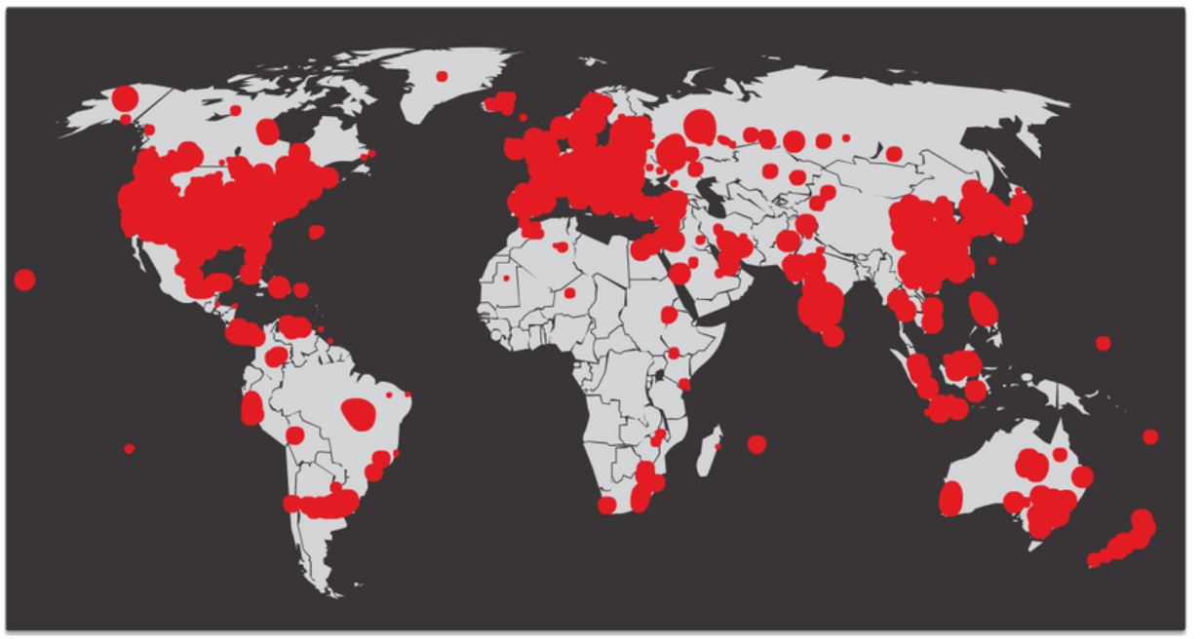
Malware
Worms
Computer worms are like viruses because they replicate and can cause the same type of damage. Specifically, worms replicate themselves by independently exploiting vulnerabilities in networks. Worms can slow down networks as they spread from system to system.
SQL Slammer, known as the worm that ate the internet, was a denial of service (DoS) attack that exploited a buffer overflow bug in Microsoft’s SQL Server. At its peak, the number of infected servers doubled in size every 8.5 seconds. It infected 250,000+ hosts within 30 minutes, as shown in the figure.
Notes:
2: Network Threats 2.3: Malware 2.3.5: Worms

Slide 35
Malware
Worm Components
Most worm attacks consist of three components:
Enabling vulnerability - A worm installs itself using an exploit mechanism, such as an email attachment, an executable file, or a Trojan horse, on a vulnerable system.
Propagation mechanism - After gaining access to a device, the worm replicates itself and locates new targets.
Payload - Any malicious code that results in some action is a payload. Most often this is used to create a backdoor that allows a threat actor access to the infected host or to create a DoS attack.
Notes:
2: Network Threats 2.3: Malware 2.3.6: Worm Components

Slide 36
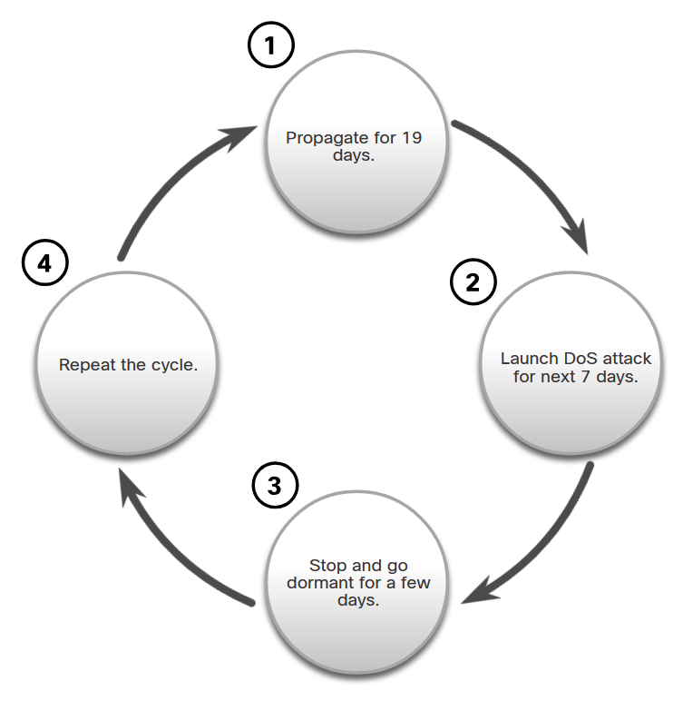
Malware
Worm Components (Cont.)
The propagation technique used by the Code Red worm is shown in the figure.
Notes:
2: Network Threats 2.3: Malware 2.3.6: Worm Components (Cont.)

Slide 37
Malware
Ransomware
Currently, the most dominant malware is ransomware.
Ransomware is malware that denies access to the infected computer system or its data. The cybercriminals then demand payment to release the computer system.
Ransomware has evolved to become the most profitable malware type in history.
There are dozens of ransomware variants.
Ransomware frequently uses an encryption algorithm to encrypt system files and data.
Payments are typically paid in Bitcoin because users of bitcoin can remain anonymous.
Email and malicious advertising, also known as malvertising, are vectors for ransomware campaigns.
Social engineering is also used.
Notes:
2: Network Threats 2.3: Malware 2.3.7: Ransomware

Slide 38
Malware
Other Malware
These are some examples of the varieties of modern malware:
Type of Malware | Description
Spyware | Used to gather information about a user and send the information to another entity without the user’s consent. Spyware can be a system monitor, Trojan horse, Adware, tracking cookies, and key loggers.
Adware | Displays annoying pop-ups to generate revenue for its author. The malware may analyze user interests by tracking the websites visited. It can then send pop-up advertising pertinent to those sites.
Scareware | Includes scam software which uses social engineering to shock or induce anxiety by creating the perception of a threat. It is generally directed at an unsuspecting user and attempts to persuade the user to infect a computer by taking action to address the bogus threat.
Phishing | Attempts to convince people to divulge sensitive information. Examples include receiving an email from their bank asking users to divulge their account and PIN numbers.
Rootkits | Installed on a compromised system. After it is installed, it continues to hide its intrusion and provide privileged access to the threat actor.
Notes:
2: Network Threats 2.3: Malware 2.3.8: Other Malware

Slide 39
Malware
Common Malware Behaviors
Computers infected with malware often exhibit one or more of the following symptoms:
Appearance of strange files, programs, or desktop icons
Antivirus and firewall programs are turning off or reconfiguring settings
Computer screen is freezing or system is crashing
Emails are spontaneously being sent to your contact list without your knowledge
Files have been modified or deleted
Increased CPU and/or memory usage
Problems connecting to networks
Slow computer or web browser speeds
Unknown processes or services running
Unknown TCP or UDP ports open
Connections are made to hosts on the internet without user action
Other strange computer behavior
Notes:
2: Network Threats 2.3: Malware 2.3.9: Common Malware Behaviors
2.3.10: Check Your Understanding - Malware

Slide 40
2.4 Common Network Attacks - Reconnaissance, Access, and Social Engineering
Notes:
2: Network Threats 2.4: Common Network Attacks - Reconnaissance, Access, and Social Engineering

Slide 41
Common Network Attacks - Reconnaissance, Access, and Social Engineering
Types of Network Attacks
To mitigate attacks, it is useful to first categorize the various types of attacks. By categorizing network attacks, it is possible to address types of attacks rather than individual attacks.
Although there is no standardized way of categorizing network attacks, the method used in this course classifies attacks in three major categories.
Reconnaissance Attacks
Access Attacks
DoS Attacks
Notes:
2: Network Threats 2.4: Common Network Attacks - Reconnaissance, Access, and Social Engineering 2.4.1: Types of Network Attacks

Slide 42
Common Network Attacks - Reconnaissance, Access, and Social Engineering
Reconnaissance Attacks
Reconnaissance is information gathering. Threat actors use reconnaissance (or recon) attacks to do unauthorized discovery and mapping of systems, services, or vulnerabilities. Recon attacks precede access attacks or DoS attacks. Some of the techniques used by malicious threat actors to conduct reconnaissance attacks are described in the table.
Technique | Description
Perform an information query of a target | The threat actor is looking for initial information about a target. Various tools can be used, including the Google search, organizations website, whois, and more.
Initiate a ping sweep of the target network | The information query usually reveals the target’s network address. The threat actor can now initiate a ping sweep to determine which IP addresses are active.
Initiate a port scan of active IP addresses | This is used to determine which ports or services are available. Examples of port scanners include Nmap, SuperScan, Angry IP Scanner, and NetScanTools.
Run vulnerability scanners | This is to query the identified ports to determine the type and version of the application and operating system that is running on the host. Examples of tools include Nipper, Secuna PSI, Core Impact, Nessus v6, SAINT, and Open VAS.
Run exploitation tools | The threat actor now attempts to discover vulnerable services that can be exploited. A variety of vulnerability exploitation tools exist including Metasploit, Core Impact, Sqlmap, Social Engineer Toolkit, and Netsparker.
Notes:
2: Network Threats 2.4: Common Network Attacks - Reconnaissance, Access, and Social Engineering 2.4.2: Reconnaissance Attacks

Slide 43
Common Network Attacks - Reconnaissance, Access, and Social Engineering
Access Attacks
Access attacks exploit known vulnerabilities in authentication services, FTP services, and web services. The purpose of this type of attack is to gain entry to web accounts, confidential databases, and other sensitive information.
Technique | Description
Password Attacks | In a password attack, the threat actor attempts to discover critical system passwords using various methods.
Spoofing Attacks | In spoofing attacks, the threat actor’s device attempts to pose as another device by falsifying data. Common spoofing attacks include IP spoofing, MAC spoofing, and DHCP spoofing.
Trust Exploitation | In a trust exploitation attack, a threat actor uses unauthorized privileges to gain access to a system, possibly compromising the target.
Port redirection | In a port redirection attack, a threat actor uses a compromised system as a base for attacks against other targets.
Man-in-the-Middle | In a man-in-the-middle attack, the threat actor is positioned in between two legitimate entities in order to read or modify the data that passes between the two parties.
Buffer Overflow Attack | In a buffer overflow attack, the threat actor exploits the buffer memory and overwhelms it with unexpected values. This usually renders the system inoperable, resulting in a DoS attack.
Notes:
2: Network Threats 2.4: Common Network Attacks - Reconnaissance, Access, and Social Engineering 2.4.4: Access Attacks

Slide 44
Common Network Attacks - Reconnaissance, Access, and Social Engineering
Social Engineering Attacks
Social engineering is an access attack that attempts to manipulate individuals into performing actions or divulging confidential information. Information about social engineering techniques is shown in the table.
Social Engineering Attack | Description
Pretexting | A threat actor pretends to need personal or financial data to confirm the identity of the recipient.
Phishing | A threat actor sends fraudulent email which is disguised as being from a legitimate, trusted source to trick the recipient into installing malware on their device, or to share personal or financial information.
Spear phishing | A threat actor creates a targeted phishing attack tailored for a specific individual or organization.
Spam | Also known as junk mail, this is unsolicited email which often contains harmful links, malware, or deceptive content.
Something for Something | Sometimes called “Quid pro quo”, this is when a threat actor requests personal information from a party in exchange for something such as a gift.
Baiting | A threat actor leaves a malware-infected flash drive in a public location. A victim finds the drive and unsuspectingly inserts it into their laptop, unintentionally installing malware.
Impersonation | In this type of attack, a threat actor pretends to be someone else to gain the trust of a victim.
Notes:
2: Network Threats 2.4: Common Network Attacks - Reconnaissance, Access, and Social Engineering 2.4.6: Social Engineering Attacks

Slide 45
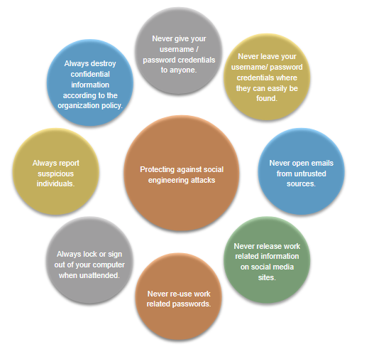
Common Network Attacks - Reconnaissance, Access, and Social Engineering
Social Engineering Attacks (Cont.)
Social Engineering Attack | Description
Tailgating | This is where a threat actor quickly follows an authorized person into a secure location to gain access to a secure area.
Shoulder surfing | This is where a threat actor inconspicuously looks over someone’s shoulder to steal their passwords or other information.
Dumpster diving | This is where a threat actor rummages through trash bins to discover confidential documents.
Notes:
2: Network Threats 2.4: Common Network Attacks - Reconnaissance, Access, and Social Engineering 2.4.6: Social Engineering Attacks (Cont.)

Slide 46
Common Network Attacks - Reconnaissance, Access, and Social Engineering
Strengthening the Weakest Link
Cybersecurity is only as strong as its weakest link. Because computers and other internet-connected devices have become an essential part of our lives, they no longer seem new or different.
The weakest link in cybersecurity can be the personnel within an organization, and social engineering is a major security threat. Because of this, one of the most effective security measures that an organization can take is to train its personnel and create a “security-aware culture.”
Notes:
2: Network Threats 2.4: Common Network Attacks - Reconnaissance, Access, and Social Engineering 2.4.7: Strengthening the Weakest Link

Slide 47
2.5 Network Attacks - Denial of Service, Buffer Overflows, and Evasion
Notes:
2: Network Threats 2.5: Network Attacks - Denial of Service, Buffer Overflows, and Evasion

Slide 48
Network Attacks - Denial of Service, Buffer Overflows, and Evasion
DoS and DDoS Attacks
A Denial of Service (DoS) attack creates some sort of interruption of network services to users, devices, or applications. There are two major types of DoS attacks:
Overwhelming Quantity of Traffic
Maliciously Formatted Packets
A Distributed DoS Attack (DDoS) is like a DoS attack, but it originates from multiple, coordinated sources.
Notes:
2: Network Threats 2.5: Network Attacks - Denial of Service, Buffer Overflows, and Evasion 2.5.2: DoS and DDoS Attacks

Slide 49
Network Attacks - Denial of Service, Buffer Overflows, and Evasion
Components of DDoS Attacks
If threat actors can compromise many hosts, they can perform a Distributed DoS Attack (DDoS). DDoS attacks are similar in intent to DoS attacks, except that a DDoS attack increases in magnitude because it originates from multiple, coordinated sources. The following terms are used to describe components of a DDoS attack:
Component | Description
zombies | This refers to a group of compromised hosts (i.e., agents). These hosts run malicious code referred to as robots (i.e., bots). The zombie malware continually attempts to self-propagate like a worm.
bots | Bots are malware that is designed to infect a host and communicate with a handler system. Bots can also log keystrokes, gather passwords, capture and analyze packets, and more.
botnet | This refers to a group of zombies that have been infected using self-propagating malware (i.e., bots) and are controlled by handlers.
handlers | This refers to a master command-and-control (CnC or C2) server controlling groups of zombies. The originator of a botnet can use Internet Relay Chat (IRC) or a web server on the C2 server to remotely control the zombies.
botmaster | This is the threat actor who is in control of the botnet and handlers.
Notes:
2: Network Threats 2.5: Network Attacks - Denial of Service, Buffer Overflows, and Evasion 2.5.3: Components of DDoS Attacks

Slide 50
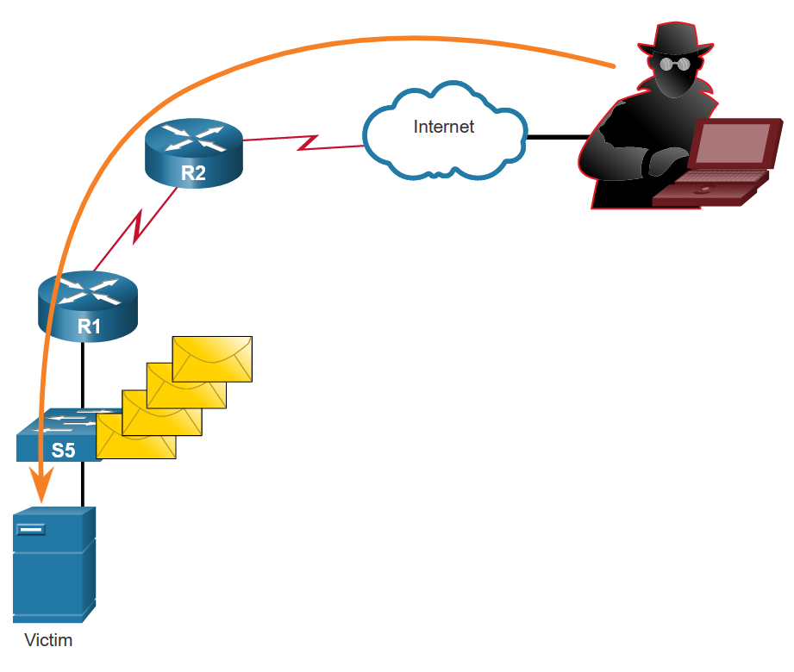
Network Attacks - Denial of Service, Buffer Overflows, and Evasion
Buffer Overflow Attack
The goal of a threat actor when using a buffer overflow DoS attack is to find a system memory-related flaw on a server and exploit it. Exploiting the buffer memory by overwhelming it with unexpected values usually renders the system inoperable, creating a DoS attack.
It is estimated that one third of malicious attacks are the result of buffer overflows.
Notes:
2: Network Threats 2.5: Network Attacks - Denial of Service, Buffer Overflows, and Evasion 2.5.5: Buffer Overflow Attack

Slide 51
Network Attacks - Denial of Service, Buffer Overflows, and Evasion
Evasion Methods
Some of the evasion methods used by threat actors include:
Evasion Method | Description
Encryption and tunneling | This evasion technique uses tunneling to hide, or encryption to scramble, malware files. This makes it difficult for many security detection techniques to detect and identify the malware. Tunneling can mean hiding stolen data inside of legitimate packets.
Resource exhaustion | This evasion technique makes the target host too busy to properly use security detection techniques.
Traffic fragmentation | This evasion technique splits a malicious payload into smaller packets to bypass network security detection. After the fragmented packets bypass the security detection system, the malware is reassembled and may begin sending sensitive data out of the network.
Protocol-level misinterpretation | This evasion technique occurs when network defenses do not properly handle features of a PDU like a checksum or TTL value. This can trick a firewall into ignoring packets that it should check.
Traffic substitution | In this evasion technique, the threat actor attempts to trick an IPS by obfuscating the data in the payload. This is done by encoding it in a different format. For example, the threat actor could use encoded traffic in Unicode instead of ASCII. The IPS does not recognize the true meaning of the data, but the target end system can read the data.
Notes:
2: Network Threats 2.5: Network Attacks - Denial of Service, Buffer Overflows, and Evasion 2.5.6: Evasion Methods

Slide 52
Network Attacks - Denial of Service, Buffer Overflows, and Evasion
Evasion Methods (Cont.)
Evasion Method | Description
Traffic insertion | Similar to traffic substitution, but the threat actor inserts extra bytes of data in a sequence of malicious data. The IPS rules miss the malicious data, accepting the full sequence of data.
Pivoting | This technique assumes that the threat actor has compromised an inside host and wants to expand their access further into the compromised network. An example is a threat actor who has gained access to the administrator password on a compromised host and is attempting to login to another host using the same credentials.
Rootkits | A rootkit is a complex attacker tool used by experienced threat actors. It integrates with the lowest levels of the operating system. When a program attempts to list files, processes, or network connections, the rootkit presents a sanitized version of the output, eliminating any incriminating output. The goal of the rootkit is to completely hide the activities of the attacker on the local system.
Proxies | Network traffic can be redirected through intermediate systems in order to hide the ultimate destination for stolen data. In this way, known command-and-control cannot be blocked by an enterprise because the proxy destination appears benign. Additionally, if data is being stolen, the destination for the stolen data can be distributed among many proxies, thus not drawing attention to the fact that a single unknown destination is serving as the destination for large amounts of network traffic.
Notes:
2: Network Threats 2.5: Network Attacks - Denial of Service, Buffer Overflows, and Evasion 2.5.6: Evasion Methods (Cont.)
2.5.7: Check Your Understanding - Identify the Types of Network Attacks

Slide 53
Module 3: Mitigating Threats
Networking Security v1.0
(NETSEC)
Notes:
Networking Security (NETSEC) Module 3: Mitigating Threats

Slide 54
3.1 Defending the Network
Notes:
3: Mitigating Threats 3.1: Defending the Network

Slide 55
Defending the Network
Network Security Professionals
Network security professionals are responsible for maintaining data assurance for an organization and ensuring the integrity and confidentiality of information.
Security specialist job roles within an enterprise include Chief Information Officer (CIO), Chief Information Security Officer (CISO), Security Operations (SecOps) Manager, Chief Security Officer (CSO), Security Manager, and Network Security Engineer. Regardless of job titles, network security professionals must always stay one step ahead of the hackers:
They must constantly upgrade their skill set to keep abreast of the latest threats.
They must attend training and workshops.
They must subscribe to real-time feeds regarding threats.
They must peruse security websites daily.
They must maintain familiarity with network security organizations. These organizations often have the latest information on threats and vulnerabilities.
Notes:
3: Mitigating Threats 3.1: Defending the Network 3.1.1: Network Security Professionals

Slide 56
Defending the Network
Network Intelligence Communities
Organization | Description
SANS | SysAdmin, Audit, Network, Security (SANS) Institute resources are largely free upon request and include: The Internet Storm Center - the popular internet early warning system NewsBites, the weekly digest of news articles about computer security. @RISK, the weekly digest of newly discovered attack vectors, vulnerabilities with active exploits, and explanations of how recent attacks worked Flash security alerts Reading Room - more than 1,200 award-winning, original research papers. SANS also develops security courses.
Mitre | The Mitre Corporation maintains a list of common vulnerabilities and exposures (CVE) used by prominent security organizations.
Notes:
3: Mitigating Threats 3.1: Defending the Network 3.1.2: Network Intelligence Communities

Slide 57
Defending the Network
Network Intelligence Communities (Cont.)
Organization | Description
FIRST | Forum of Incident Response and Security Teams (FIRST) is a security organization that brings together a variety of computer security incident response teams from government, commercial, and educational organizations to foster cooperation and coordination in information sharing, incident prevention and rapid reaction.
SecurityNewsWire | A security news portal that aggregates the latest breaking news pertaining to alerts, exploits, and vulnerabilities.
(ISC)² | International Information Systems Security Certification Consortium (ISC²) provides vendor neutral education products and career services to more than 75,000+ industry professionals in more than 135 countries.
CIS | The Center for Internet Security (CIS) is a focal point for cyber threat prevention, protection, response, and recovery for state, local, tribal, and territorial (SLTT) governments through the Multi-State Information Sharing and Analysis Center (MS-ISAC). The MS-ISAC offers 24x7 cyber threat warnings and advisories, vulnerability identification, and mitigation and incident response.
Notes:
3: Mitigating Threats 3.1: Defending the Network 3.1.2: Network Intelligence Communities (Cont.)

Slide 58
Defending the Network
Network Security Certifications
Certifications for network security professionals are offered by the following organizations:
Global Information Assurance Certification (GIAC)
International Information System Security Certification Consortium (ISC)²
Information Systems Audit and Control Association (ISACA)
International Council of E-Commerce Consultants (EC-Council)
Certified Wireless Network Professionals (CWNP)
Cisco has replaced the Cisco Certified Network Associate Security (210-260 IINS) certification with a new CCNP Security certification. CCNP Security consists of the CCNP Core exam combined with a Cisco Certified Specialist security concentration exam:
300-710 SNCF - Network Security Firepower
300-715 SISE - Implementing and Configuring Cisco Identity Services Engine
300-720 SESA - Securing Email with Cisco Email Security Appliance
300-725 SWSA - Securing the Web with Cisco Web Security Appliance
300-730 SVPN - Implementing Secure Solutions with Virtual Private Networks
300-735 SAUTO - Automating and Programming Cisco Security Solutions
Notes:
3: Mitigating Threats 3.1: Defending the Network 3.1.3: Network Security Certifications

Slide 59
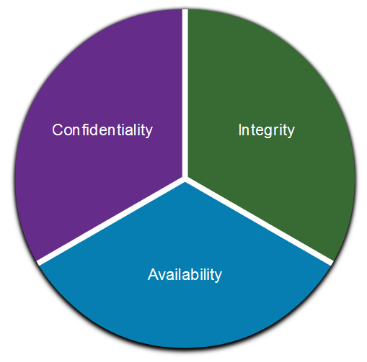
Defending the Network
Communications Security: CIA
Information security deals with protecting information and information systems from unauthorized access, use, disclosure, disruption, modification, or destruction. The CIA Triad serves as a conceptual foundation for the field.
The CIA Triad consists of three components of information security:
Confidentiality - Only authorized individuals, entities, or processes can access sensitive information.
Integrity - This refers to the protection of data from unauthorized alteration.
Availability - Authorized users must have uninterrupted access to the network resources and data that they require.
Notes:
3: Mitigating Threats 3.1: Defending the Network 3.1.4: Communications Security: CIA

Slide 60
3.2 Network Security Policies
Notes:
3: Mitigating Threats 3.2: Network Security Policies

Slide 61
Network Security Policies
Network Security Domains
There are 14 network security domains specified by the International Organization for Standardization (ISO)/International Electrotechnical Commission (IEC).
Network Security Domain | Description
Information Security Policies | This annex is designed to ensure that security policies are created, reviewed, and maintained.
Organization of Information Security | This is the governance model set out by an organization for information security. It assigns responsibilities for information security tasks within in organization.
Human Resources Security | This addresses security responsibilities relating to employees joining, moving within, and leaving an organization.
Asset Management | This concerns the way that organizations create an inventory of and classification scheme for information assets.
Access Control | This describes the restriction of access rights to networks, systems, applications, functions, and data.
Cryptography | This concerns data encryption and the management of sensitive information to protect confidentiality, integrity, and availability of data.
Physical and Environmental Security | This describes the protection of the physical computer facilities and equipment within an organization.
Notes:
3: Mitigating Threats 3.2: Network Security Policies 3.2.1: Network Security Domains

Slide 62
Network Security Policies
Network Security Domains (Cont.)
Network Security Domain | Description
Operations Security | This describes the management of technical security controls in systems and networks including malware defenses, data backup, logging and monitoring, vulnerability management, and audit considerations. This domain is also concerned with the integrity of software that is used in business operations.
Communications Security | This concerns the security of data as it is communicated on networks, both within an organization or between and organization and third parties such as customers or suppliers.
System Acquisition, Development, and Maintenance | This ensures that information security remains a central concern in an organization’s processes across the entire lifecycle, in both private and public networks.
Supplier Relationships | This concerns the specification of contractual agreements that protect an organization’s information and technology assets that are accessible by third parties that provide supplies and services to the organization.
Information Security Incident Management | This describes how to anticipate and respond to information security breaches.
Notes:
3: Mitigating Threats 3.2: Network Security Policies 3.2.1: Network Security Domains (Cont.)

Slide 63
Network Security Policies
Network Security Domains (Cont.)
Network Security Domain | Description
Business Continuity Management | This describes the protection, maintenance, and recovery of business-critical processes and systems.
Compliance | This describes the process of ensuring conformance with information security policies, standards, and regulations.
Notes:
3: Mitigating Threats 3.2: Network Security Policies 3.2.1: Network Security Domains (Cont.)

Slide 64
Network Security Policies
Business Policies
Business policies are the guidelines that are developed by an organization to govern its actions. The policies define standards of correct behavior for the business and its employees. In networking, policies define the activities that are allowed on the network. This sets a baseline of acceptable use. If behavior that violates business policy is detected on the network, it is possible that a security breach has occurred.
Policy | Description
Company policies | These policies establish the rules of conduct and the responsibilities of both employees and employers. Policies protect the rights of workers as well as the business interests of employers. Depending on the needs of the organization, various policies and procedures establish rules regarding employee conduct, attendance, dress code, privacy and other areas related to the terms and conditions of employment.
Employee policies | These policies are created and maintained by human resources staff to identify employee salary, pay schedule, employee benefits, work schedule, vacations, and more. They are often provided to new employees to review and sign.
Notes:
3: Mitigating Threats 3.2: Network Security Policies 3.2.2: Business Policies

Slide 65
Network Security Policies
Business Policies (Cont.)
Policy | Description
Security policies | These policies identify a set of security objectives for a company, define the rules of behavior for users and administrators, and specify system requirements. These objectives, rules, and requirements collectively ensure the security of a network and the computer systems in an organization. Much like a continuity plan, a security policy is a constantly evolving document based on changes in the threat landscape, vulnerabilities, and business and employee requirements.
Notes:
3: Mitigating Threats 3.2: Network Security Policies 3.2.2: Business Policies(Cont.)

Slide 66
Network Security Policies
Security Policy
Security policies are used to inform users, staff, and managers of an organization’s requirements for protecting technology and information assets. A security policy also specifies the mechanisms that are needed to meet security requirements and provides a baseline from which to acquire, configure, and audit computer systems and networks for compliance. Policies that may be included in a security policy are:
Policy | Description
Identification and authentication policy | Specifies authorized persons that can have access to network resources and identity verification procedures.
Password policies | Ensures passwords meet minimum requirements and are changed regularly.
Acceptable Use Policy (AUP) | Identifies network applications and uses that are acceptable to the organization. It may also identify ramifications if this policy is violated.
Remote access policy | Identifies how remote users can access a network and what is accessible via remote connectivity.
Network maintenance policy | Specifies network device operating systems and end user application update procedures.
Incident handling procedures | Describes how security incidents are handled.
Notes:
3: Mitigating Threats 3.2: Network Security Policies 3.2.3: Security Policy

Slide 67
Network Security Policies
BYOD Policies
Many organizations must now also support Bring Your Own Device (BYOD). This enables employees to use their own mobile devices to access company systems, software, networks, or information. This can bring an increased information security risk because BYOD can lead to data breaches and greater liability for the organization. BYOD security best practices to help mitigate BYOD vulnerabilities are:
Best Practice | Description
Password protected access | Use unique passwords for each device and account.
Manually control wireless connectivity | Turn off Wi-Fi and Bluetooth connectivity when not in use. Connect only to trusted networks.
Keep updated | Always keep the device OS and other software updated. Updated software often contains security patches to mitigate against the latest threats or exploits.
Back up data | Enable backup of the device in case it is lost or stolen.
Enable “Find my Device” | Subscribe to a device locator service with remote wipe feature.
Provide antivirus software | Provide antivirus software for approved BYOD devices.
Use Mobile Device Management (MDM) software | MDM software enables IT teams to implement security settings and software configurations on all devices that connect to company networks.
Notes:
3: Mitigating Threats 3.2: Network Security Policies 3.2.4: BYOD Policies

Slide 68
Network Security Policies
Regulatory and Standards Compliance
There are also external regulations regarding network security. Network security professionals must be familiar with the laws and codes of ethics that are binding on Information Systems Security (INFOSEC) professionals.
Many organizations are mandated to develop and implement security policies. Compliance regulations define what organizations are responsible for providing and the liability if they fail to comply. The compliance regulations that an organization is obligated to follow depend on the type of organization and the data that the organization handles.
Notes:
3: Mitigating Threats 3.2: Network Security Policies 3.2.5: Regulatory and Standards Compliance

Slide 69
3.3 Security Tools, Platforms, and Services
Notes:
3: Mitigating Threats 3.3: Security Tools, Platforms, and Services

Slide 70
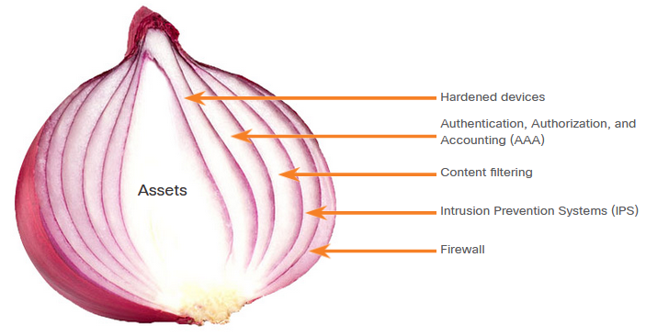
Security Tools, Platforms, and Services
The Security Onion and The Security Artichoke
A common analogy used to describe a defense-in-depth approach is called “the security onion.” A threat actor would have to peel away at a network’s defenses layer by layer in a manner similar to peeling an onion. Only after penetrating each layer would the threat actor reach the target data or system.
Note: The security onion described on this page is a way of visualizing defense-in-depth. This is not to be confused with the Security Onion suite of network security tools.
Notes:
3: Mitigating Threats 3.3: Security Tools, Platforms, and Services 3.3.1: The Security Onion and The Security Artichoke

Slide 71
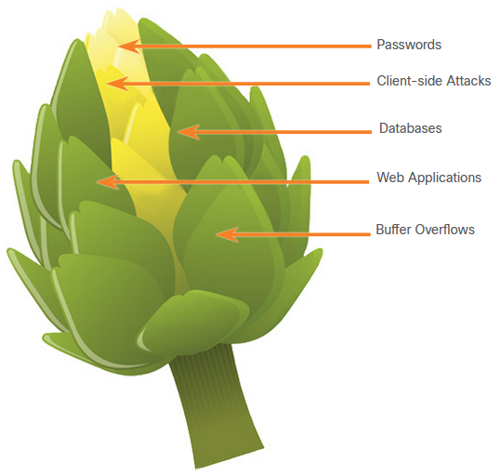
Security Tools, Platforms, and Services
The Security Onion and The Security Artichoke (Cont.)
The changing landscape of networking, such as the evolution of borderless networks, has changed Security onion analogy to the “security artichoke”, which benefits threat actors because they no longer have to peel away each layer. They only need to remove certain “artichoke leaves.” The threat actor peels away the security armor along the perimeter to get to the “heart” of the enterprise.
Notes:
3: Mitigating Threats 3.3: Security Tools, Platforms, and Services 3.3.1: The Security Onion and The Security Artichoke (Cont.)

Slide 72
Security Tools, Platforms, and Services
Security Testing Tools
Ethical hacking involves using different types of tools to test the network and end devices to validate the security of the network. Penetration testing uses hacker techniques and tools to evaluate the strength of network security measures. Cybersecurity personnel must also know how to use these tools when performing network penetration tests.
Categories of Tools | Description
password crackers | Passwords are the most vulnerable security threat. Password cracking tools are often referred to as password recovery tools and can be used to crack or recover the password. This is accomplished either by removing the original password, after bypassing the data encryption, or by outright discovery of the password. Password crackers repeatedly make guesses in order to crack the password and access the system. Examples of password cracking tools include John the Ripper, Ophcrack, L0phtCrack, THC Hydra, RainbowCrack, and Medusa.
wireless hacking tools | Wireless networks are more susceptible to network security threats. Wireless hacking tools are used to intentionally hack into a wireless network to detect security vulnerabilities. Examples of wireless hacking tools include Aircrack-ng, Kismet, InSSIDer, KisMAC, Firesheep, and NetStumbler.
Notes:
3: Mitigating Threats 3.3: Security Tools, Platforms, and Services 3.3.2: Security Testing Tools

Slide 73
Security Tools, Platforms, and Services
Security Testing Tools (Cont.)
Categories of Tools | Description
network scanning and hacking tools | Network scanning tools are used to probe network devices, servers, and hosts for open TCP or UDP ports. Examples of scanning tools include Nmap, SuperScan, Angry IP Scanner, and NetScanTools.
packet crafting tools | Packet crafting tools are used to probe and test a firewall’s robustness using specially crafted forged packets. Examples of such tools include Hping, Scapy, Socat, Yersinia, Netcat, Nping, and Nemesis.
packet sniffers | Packet sniffer tools are used to capture and analyze packets within traditional Ethernet LANs or WLANs. Tools include Wireshark, Tcpdump, Ettercap, Dsniff, EtherApe, Paros, Fiddler, Ratproxy, and SSLstrip.
rootkit detectors | A rootkit detector is a directory and file integrity checker used by white hats to detect installed root kits. Example tools include AIDE, Netfilter, and PF: OpenBSD Packet Filter.
fuzzers to search vulnerabilities | Fuzzers are tools used by threat actors when attempting to discover a computer system’s security vulnerabilities. Examples of fuzzers include Skipfish, Wapiti, and W3af.
forensic tools | White hat hackers use forensic tools to sniff out any trace of evidence existing in a particular computer system. Example of tools include Sleuth Kit, Helix, Maltego, and Encase.
Notes:
3: Mitigating Threats 3.3: Security Tools, Platforms, and Services 3.3.2: Security Testing Tools (Cont.)

Slide 74
Security Tools, Platforms, and Services
Security Testing Tools (Cont.)
Categories of Tools | Description
debuggers | Debugger tools are used by black hats to reverse engineer binary files when writing exploits. They are also used by white hats when analyzing malware. Debugging tools include GDB, WinDbg, IDA Pro, and Immunity Debugger.
hacking operating systems | Hacking operating systems are specially designed operating systems preloaded with tools and technologies optimized for hacking. Examples of specially designed hacking operating systems include Kali Linux, SELinux, Knoppix, Parrot OS, and BackBox Linux.
encryption tools | These tools safeguard the contents of an organization’s data when it is stored or transmitted. Encryption tools use algorithm schemes to encode the data to prevent unauthorized access to the data. Examples of these tools include VeraCrypt, CipherShed, Open SSH, OpenSSL, OpenVPN, and Stunnel.
vulnerability exploitation tools | These tools identify whether a remote host is vulnerable to a security attack. Examples of vulnerability exploitation tools include Metasploit, Core Impact, Sqlmap, Social Engineer Tool Kit, and Netsparker.
vulnerability scanners | These tools scan a network or system to identify open ports. They can also be used to scan for known vulnerabilities and scan VMs, BYOD devices, and client databases. Examples of these tools include Nipper, Securia PSI, Core Impact, Nessus, SAINT, and Open VAS.
Notes:
3: Mitigating Threats 3.3: Security Tools, Platforms, and Services 3.3.2: Security Testing Tools (Cont.)

Slide 75

Security Tools, Platforms, and Services
Data Security Platforms
Data Security Platforms (DSP) are an integrated security solution that combines traditionally independent tools into a suite of tools that are made to work together. Security tools that protect and monitor networks are often made by different vendors. It can be difficult to integrate these tools in such a way that a single view of network security can be achieved.
One such DSP is the Helix platform from FireEye. FireEye Helix is a cloud-based security operations platform that enables organizations to integrate many security functionalities into a single platform. Helix provides event management, network behavior analytics, advanced threat detection, and incident security orchestration, automation, and response (SOAR) for response to threats as they are detected.
Notes:
3: Mitigating Threats 3.3: Security Tools, Platforms, and Services 3.3.3: Data Security Platforms

Slide 76
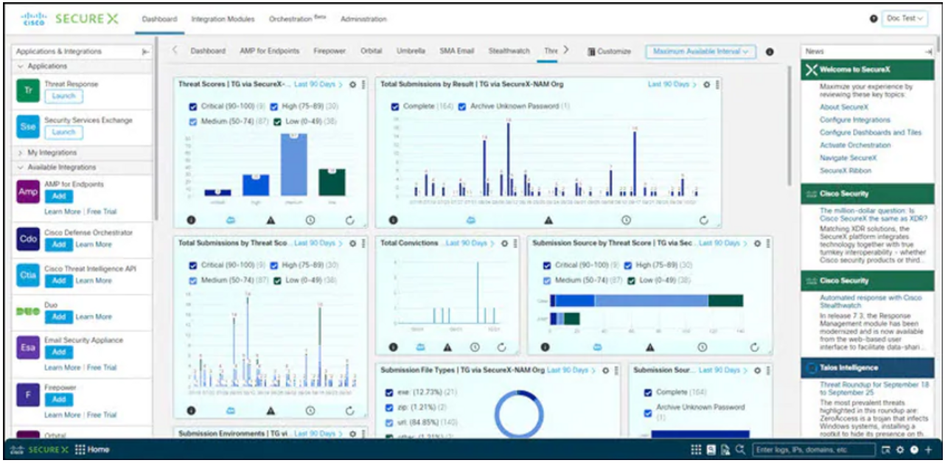
Security Tools, Platforms, and Services
Data Security Platforms (Cont.)
Another integrated DSP is Cisco SecureX. The Cisco Secure portfolio consists of a broad set of technologies that function as a team - providing interoperability with the security infrastructure, including third-party technologies. This results in unified visibility, automation, and stronger defenses. The Cisco SecureX platform works with diverse products that combine to safeguard your network, users and endpoints, cloud edge, and applications. SecureX functionality is built in to a large and diverse portfolio of Cisco security products including next-generation firewalls, VPN, network analytics, identity service engine, advanced malware protection (AMP), and many other systems that work to secure all aspects of a network. SecureX also integrates a range of third-party security tools.
Notes:
3: Mitigating Threats 3.3: Security Tools, Platforms, and Services 3.3.3: Data Security Platforms

Slide 77
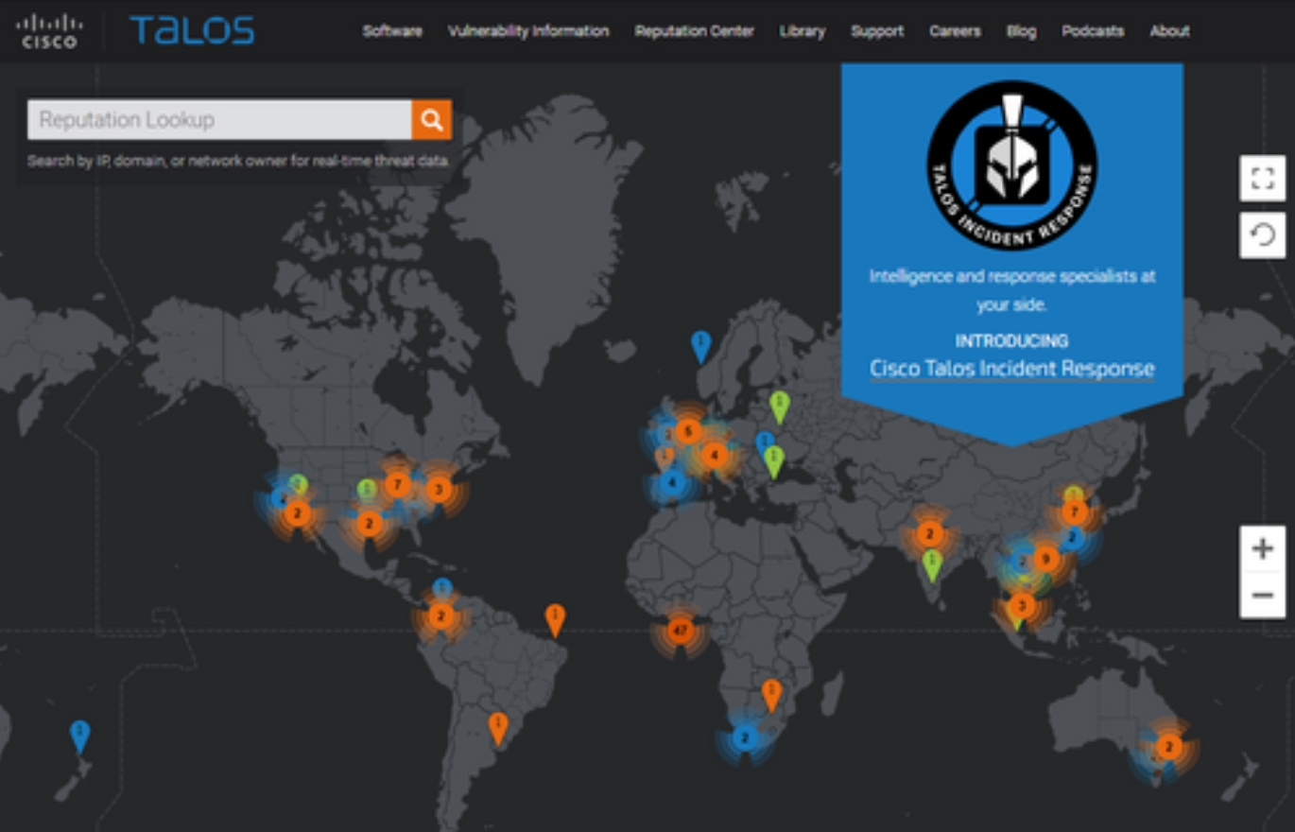
Security Tools, Platforms, and Services
Security Services
Threat intelligence and security services allow the exchange of threat information such as vulnerabilities, indicators of compromise (IOC), and mitigation techniques. As threats emerge, threat intelligence services create and distribute firewall rules and IOCs to the devices that have subscribed to the service.
One such service is the Cisco Talos Threat Intelligence Group. Talos is one of the largest commercial threat intelligence teams in the world. The goal of Talos is to help protect enterprise users, data, and infrastructure from active adversaries. The Talos team collects information about active, existing, and emerging threats. Talos then provides comprehensive protection against these attacks and malware to its subscribers.
Cisco Security products can use Talos threat intelligence in real time to provide fast and effective security solutions.
Notes:
3: Mitigating Threats 3.3: Security Tools, Platforms, and Services 3.3.5: Security Services

Slide 78
3.4 Mitigating Common Network Attacks
Notes:
3: Mitigating Threats 3.4: Mitigating Common Network Attacks

Slide 79
Mitigating Common Network Attacks
Defending the Network
Constant vigilance and ongoing education are required to defend your network against attack. The following are best practices for securing a network:
Develop a written security policy for the company.
Educate employees about the risks of social engineering, and develop strategies to validate identities over the phone, via email, or in person.
Control physical access to systems.
Use strong passwords and change them often.
Encrypt and password-protect sensitive data.
Implement security hardware and software such as firewalls, IPSs, virtual private network (VPN) devices, antivirus software, and content filtering.
Perform backups and test the backed-up files on a regular basis.
Shut down unnecessary services and ports.
Keep patches up-to-date by installing them weekly or daily, if possible, to prevent buffer overflow and privilege escalation attacks.
Perform security audits to test the network.
Notes:
3: Mitigating Threats 3.4: Mitigating Common Network Attacks 3.4.1: Defending the Network

Slide 80
Mitigating Common Network Attacks
Mitigating Malware
Malware, including viruses, worms, and Trojan horses, can cause serious problems on networks and end devices. Network administrators have several means of mitigating these attacks.
Antivirus software helps prevent hosts from getting infected and spreading malicious code. Several companies that create antivirus software, such as Symantec, McAfee, and Trend Micro. Antivirus products have update automation options so that new virus definitions and new software updates can be downloaded automatically or on demand. This practice is the most critical requirement for keeping a network free of viruses and should be formalized in a network security policy.
These products are installed on computers and servers to detect and eliminate viruses. However, they do not prevent viruses from entering the network. Another way to mitigate malware threats is to prevent malware files from entering the network at all. Security devices at the network perimeter can identify known malware files based on their indictors of compromise. The files can be removed from the incoming data stream before they can cause an incident.
Notes:
3: Mitigating Threats 3.4: Mitigating Common Network Attacks 3.4.2: Mitigating Malware

Slide 81
Mitigating Common Network Attacks
Mitigating Worms
Worms are more network-based than viruses. Worm mitigation requires diligence and coordination on the part of network security professionals. The response to a worm attack can be broken down into four phases: containment, inoculation, quarantine, and treatment.
Phase | Response
1. Containment | The containment phase involves limiting the spread of a worm infection to areas of the network that are already affected. This requires compartmentalization and segmentation of the network to slow down or stop the worm and to prevent currently infected hosts from targeting and infecting other systems. Containment requires using both outgoing and incoming ACLs on routers and firewalls at control points within the network.
2. Inoculation | The inoculation phase runs parallel to or subsequent to the containment phase. During the inoculation phase, all uninfected systems are patched with the appropriate vendor patch. The inoculation process further deprives the worm of available targets.
3. Quarantine | The quarantine phase involves tracking down and identifying infected machines within the contained areas and disconnecting, blocking, or removing them. This isolates these systems appropriately for the treatment phase.
4. Treatment | The treatment phase involves actively disinfecting infected systems. This can involve terminating the worm process, removing modified files or system settings that the worm introduced, and patching the vulnerability the worm used to exploit the system. Alternatively, in more severe cases, the system may need to be reinstalled to ensure that the worm and its by-products are removed.
Notes:
3: Mitigating Threats 3.4: Mitigating Common Network Attacks 3.4.3: Mitigating Worms

Slide 82
Mitigating Common Network Attacks
Mitigating Reconnaissance Attacks
Reconnaissance attacks are typically the precursor to other attacks that are designed to gain unauthorized access to a network or disrupt network functionality. You can detect when a reconnaissance attack is underway by receiving notifications from preconfigured alarms. These alarms are triggered when certain parameters are exceeded, such as the number of ICMP requests per second. Reconnaissance attacks can be mitigated in several ways, including the following:
Implementing authentication to ensure proper access.
Using encryption to render packet sniffer attacks useless.
Using anti-sniffer tools to detect packet sniffer attacks.
Implementing a switched infrastructure.
Using a firewall and IPS.
It is impossible to mitigate port scanning. Using an IPS and firewall can limit the information that can be discovered with a port scanner. Ping sweeps can be stopped if ICMP echo and echo-reply are turned off on edge routers; however, when these services are turned off, network diagnostic data is lost.
Notes:
3: Mitigating Threats 3.4: Mitigating Common Network Attacks 3.4.4: Mitigating Reconnaissance Attacks

Slide 83
Mitigating Common Network Attacks
Mitigating Access Attacks
Several techniques are available for mitigating access attacks, including strong password security, principle of minimum trust, cryptography, and applying operating system and application patches. A surprising number of access attacks are carried out through simple password guessing or brute-force dictionary attacks against passwords. To defend against this, create and enforce a strong authentication policy which includes:
Use strong passwords - Strong passwords are at least eight characters and contain uppercase letters, lowercase letters, numbers, and special characters.
Disable accounts after a specified number of unsuccessful logins has occurred - This practice helps to prevent continuous password attempts.
Use encryption for remote access to a network and routing protocol traffic to reduce the possibility of man-in-the-middle attacks. Educate employees about the risks of social engineering, and develop strategies to validate identities over the phone, via email, or in person. Multifactor authentication (MFA) has become increasingly common.
Notes:
3: Mitigating Threats 3.4: Mitigating Common Network Attacks 3.4.5: Mitigating Access Attacks

Slide 84
Mitigating Common Network Attacks
Mitigating DoS Attacks
One of the first signs of a DoS attack is a large number of user complaints about unavailable resources or unusually slow network performance. A network utilization graph showing unusual activity could indicate a DoS attack. To minimize the number of attacks, a network utilization software package should be running at all times.
Historically, many DoS attacks were sourced from spoofed addresses. Cisco routers and switches support many antispoofing technologies, such as port security, Dynamic Host Configuration Protocol (DHCP) snooping, IP Source Guard, Dynamic Address Resolution Protocol (ARP) Inspection, and access control lists (ACLs).
Notes:
3: Mitigating Threats 3.4: Mitigating Common Network Attacks 3.4.6: Mitigating DoS Attacks

Slide 85
3.5 Cisco Network Foundation Protection Framework
Notes:
3: Mitigating Threats 3.5: Cisco Network Foundation Protection Framework

Slide 86
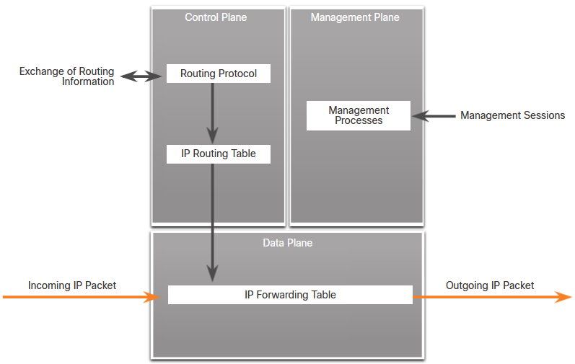
Cisco Network Foundation Protection Framework
NFP Framework
The Cisco Network Foundation Protection (NFP) framework provides comprehensive guidelines for protecting the network infrastructure. These guidelines form the foundation for continuous delivery of service. NFP logically divides routers and switches into three functional areas:
Control plane - Responsible for routing data correctly.
Management plane - Responsible for managing network elements.
Data plane - Responsible for forwarding data.
Notes:
3: Mitigating Threats 3.5: Cisco Network Foundation Protection Framework 3.5.1: NFP Framework

Slide 87
Cisco Network Foundation Protection Framework
Securing the Control Plane
Control plane traffic consists of device-generated packets required for the operation of the network itself. Control plane security can be implemented using the following features:
Routing protocol authentication - Routing protocol authentication, or neighbor authentication, prevents a router from accepting fraudulent routing updates.
Control Plane Policing (CoPP) - CoPP is a Cisco IOS feature that lets users control the flow of traffic that is handled by the route processor of a network device.
AutoSecure - This can lock down the management plane functions and the forwarding plane services and functions of a router.
CoPP is designed to prevent unnecessary traffic from overwhelming the route processor. The CoPP feature treats the control plane as a separate entity with its own ingress (input) and egress (output) ports. A set of rules can be established and associated with the ingress and egress ports of the control plane.
Notes:
3: Mitigating Threats 3.5: Cisco Network Foundation Protection Framework 3.5.2: Securing the Control Plane

Slide 88
Cisco Network Foundation Protection Framework
Securing the Management Plane
Management plane traffic is generated either by network devices or network management stations using processes and protocols such as Telnet, SSH, and TFTP, etc. The management plane is a very attractive target to hackers.
Management plane security can be implemented using the following features:
Login and password policy - Restricts device accessibility.
Present legal notification - Displays legal notices.
Ensure the confidentiality of data - Protects locally stored sensitive data from being viewed or copied. Uses management protocols with strong authentication to mitigate confidentiality attacks aimed at exposing passwords and device configurations.
Role-based access control (RBAC) - Ensures access is only granted to authenticated users, groups, and services.
Authorize actions - Restricts the actions and views that are permitted by any particular user, group, or service.
Enable management access reporting - Logs and accounts for all access.
Notes:
3: Mitigating Threats 3.5: Cisco Network Foundation Protection Framework 3.5.3: Securing the Management Plane

Slide 89
Cisco Network Foundation Protection Framework
Securing the Data Plane
Data plane traffic consists mostly of user packets being forwarded through the router. Data plane security can be implemented using ACLs, antispoofing mechanisms, and Layer 2 security features. ACLs are used to secure the data plane in a variety of ways:
Blocking unwanted traffic or users
Reducing the chance of DoS
Mitigating spoofing attacks.
Providing bandwidth control
Classifying traffic to protect the Management and Control planes
Cisco Catalyst switches can use integrated features to help secure the Layer 2 infrastructure. The following Layer 2 security tools are integrated into the Cisco Catalyst switches:
Port security
DHCP snooping
Dynamic ARP Inspection (DAI)
IP Source Guard
Notes:
3: Mitigating Threats 3.5: Cisco Network Foundation Protection Framework 3.5.4: Securing the Data Plane

